Slide 1
Relational model & SQL

Slide 2
What we will learn?
Basic concepts associated with the relational model and SQL syntax
Mainly chapter 2 of the text book and to get familiar with Single-table queries
Motivation: to get familiar with SQL syntax, start on SQLite & Google BigQuery

Slide 3


Slide 4
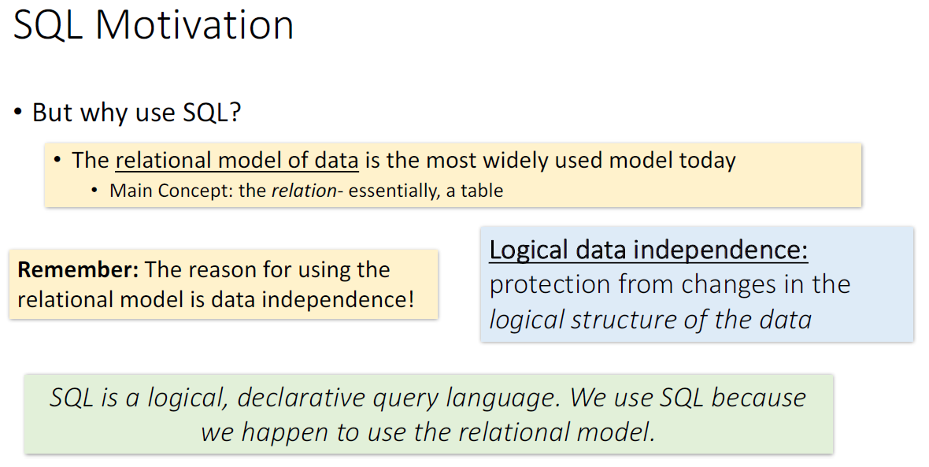

Slide 5


Slide 6
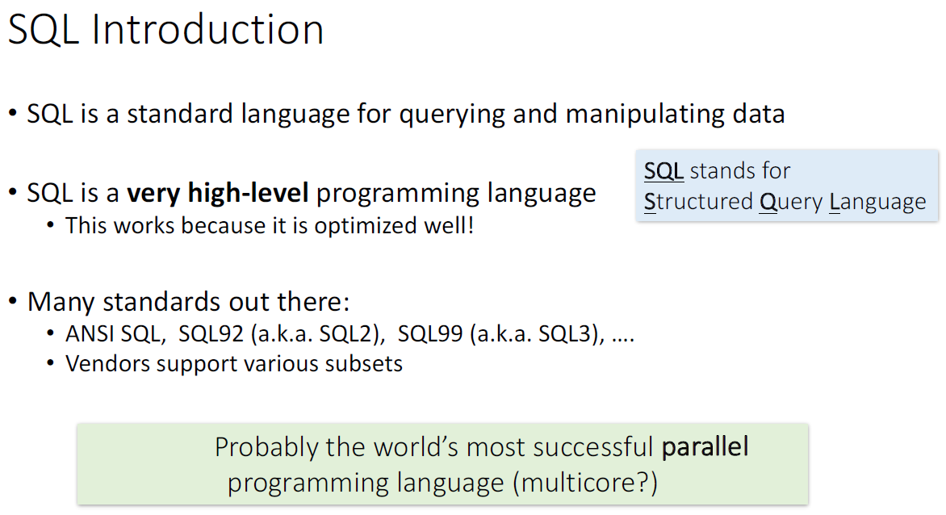

Slide 7
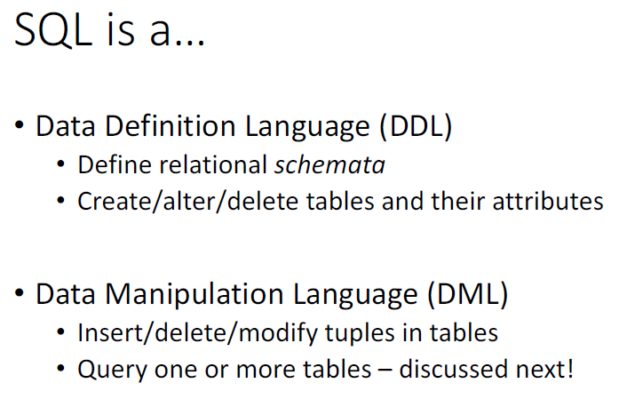

Slide 8
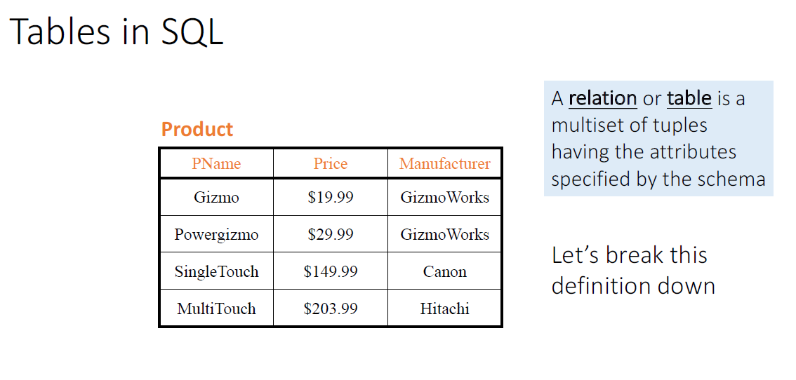

Slide 9
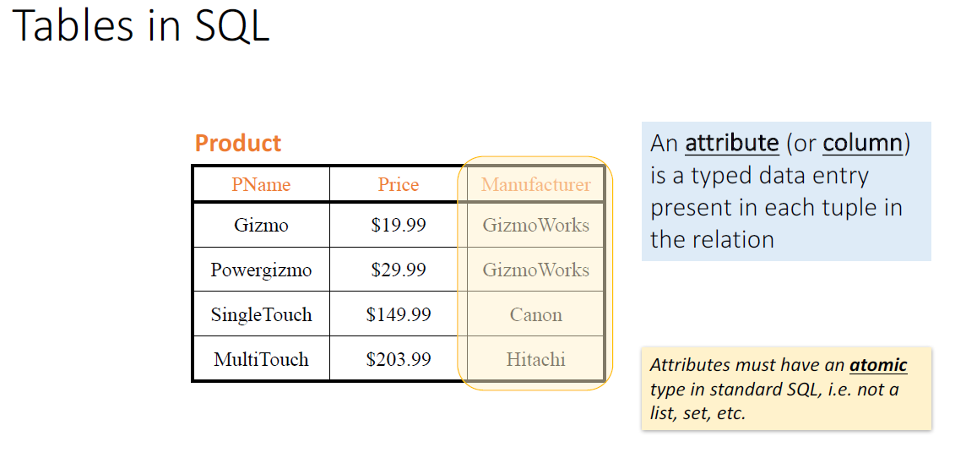

Slide 10
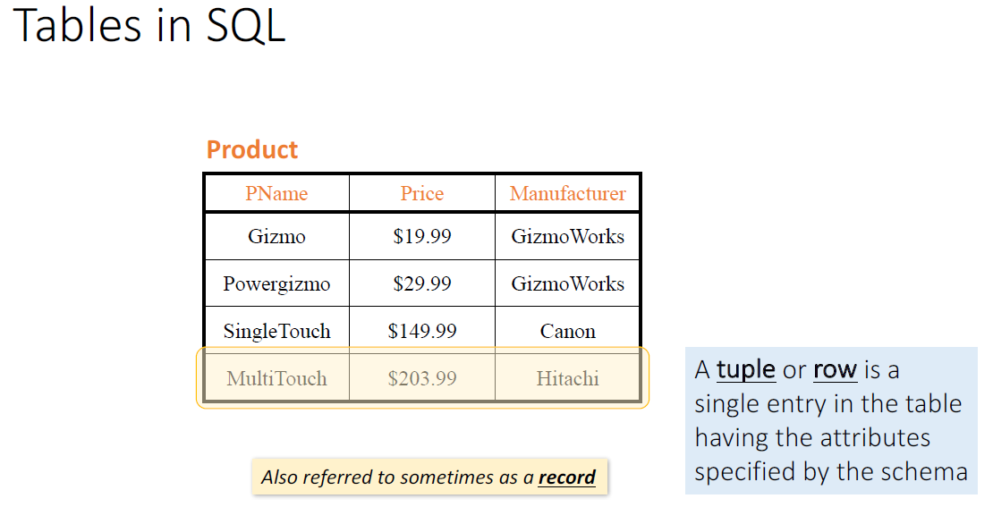

Slide 11
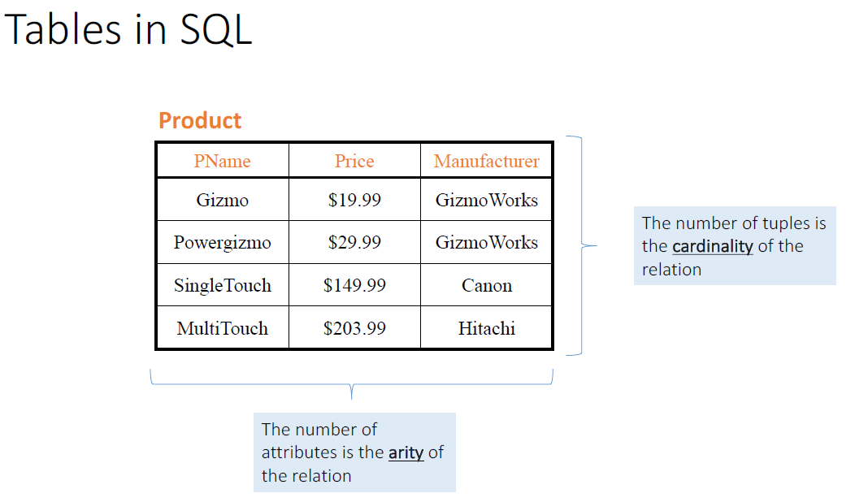

Slide 12
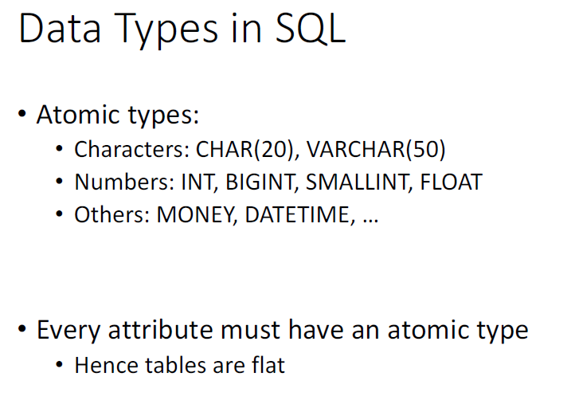

Slide 13
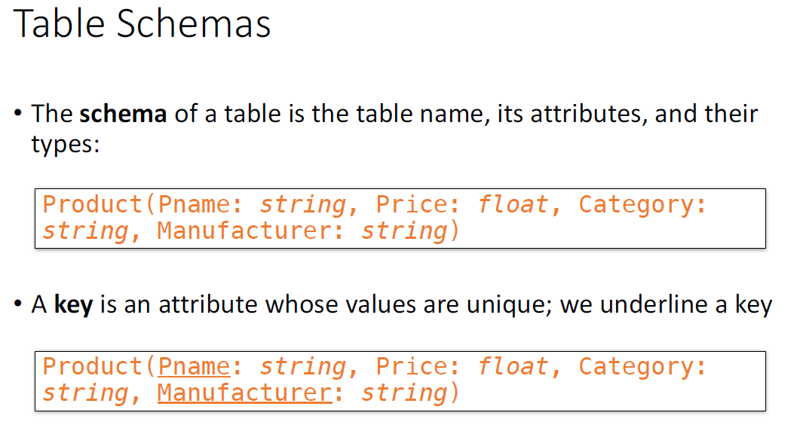

Slide 14
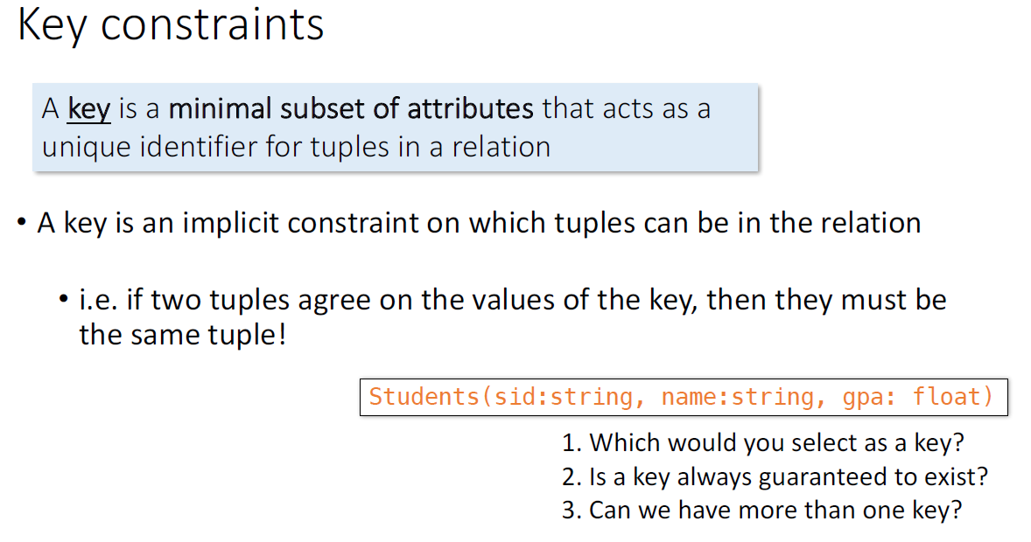

Slide 15
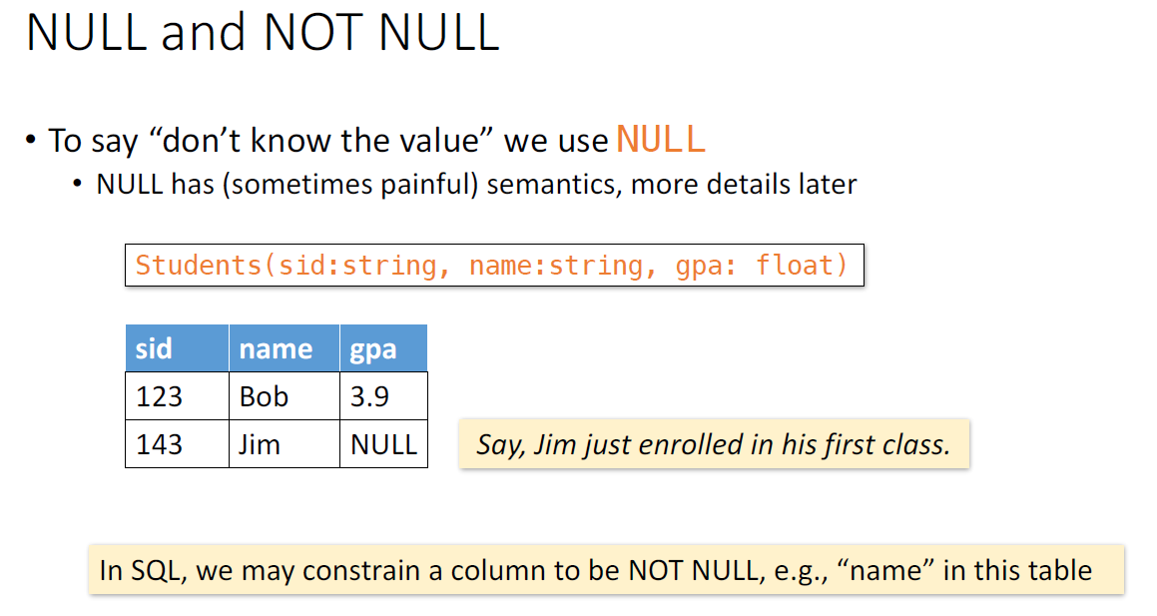

Slide 16
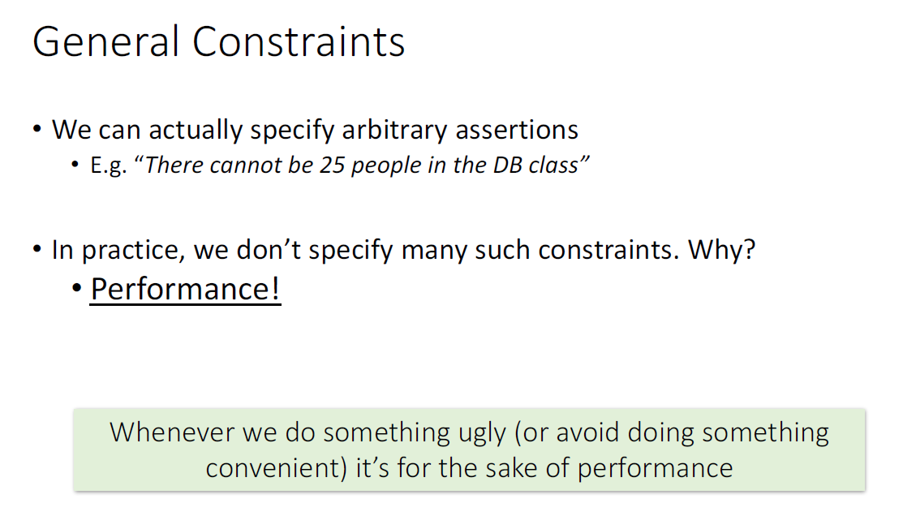

Slide 17
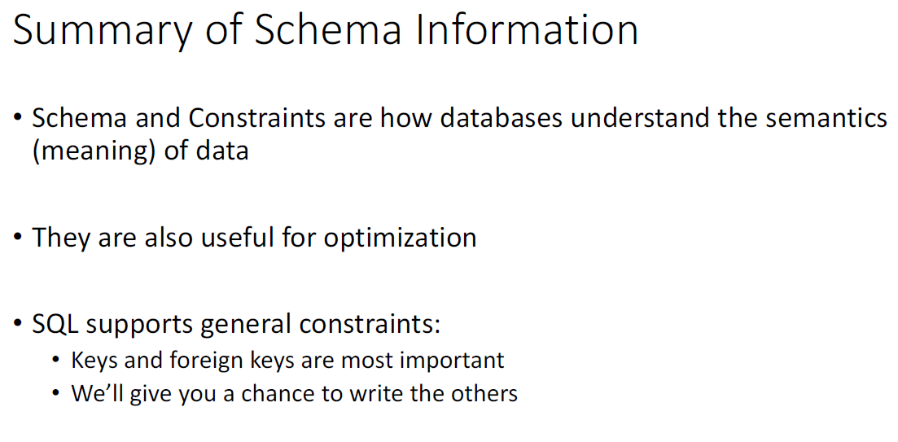

Slide 18
Chapter 2 textbook

Slide 19
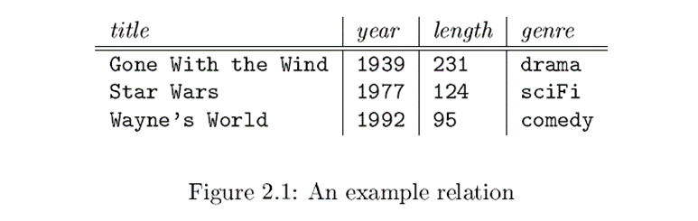
Relational model
Based on tables (which are called relations)
example table in figure 2.1 on page 19 in chapter 2 of the text book.
the Movies relation (or table)

Slide 20
Relational model
Each row (also known as a tuple) represents a movie
Columns (or attributes) represent properties of the relation Movies.
the attribute ‘length’ gives the length of each movie in minuets.
What are the other attributes of this relation?
Notes:
The relational model gives us a single way to represent data: as a two-dimensional table called a relation. The relation in Figure 2.1 (of the text book) is called Movies [normally the table (or rather relation name could be either singular/plural with the first letter a capital)
Here, the rows each represent a movie, and the columns each represent a property of movies (that we wish to consider in this database; there could have been other columns)

Slide 21
Schemas
name of a relation and the set of attributes for a relation is called the schema for that relation
how to show the schema for the relation?
Write the relation name followed by a parenthesized list of its attributes
the schema for relation Movies is show below:

Slide 22
Tuples
rows of a relation other than the header row containing the attribute names are called tuples
A tuple has a one component for each attribute of the relation
How to write a tuple separately (not as a part of a relation)?
use commas to separate components and use parentheses to surround the tuple. For example, the first tuple will look like follows:
always use the order in which the attributes were listed in the relation schema

Slide 23
Domains
each component of each tuple should be atomic
should be an elementary type such as integer or string, or char, etc.
a value cannot be a record structure, set, list or array
each attribute of a relation is associated with a domain of an elementary type
how to show domain (or data type) associated with each attribute in the schema?

Slide 24
Equivalent representations of a relation
Relations are sets of tuples, not lists of tuples
order in which the tuples are presented could be different (depends on the particular instance)
we can list the three tuples in our example in any of their six possible orders, and the ‘relation’ will be the same as shown in the Figure2.1
if we had 5 tuples how many orders are possible?

Slide 25
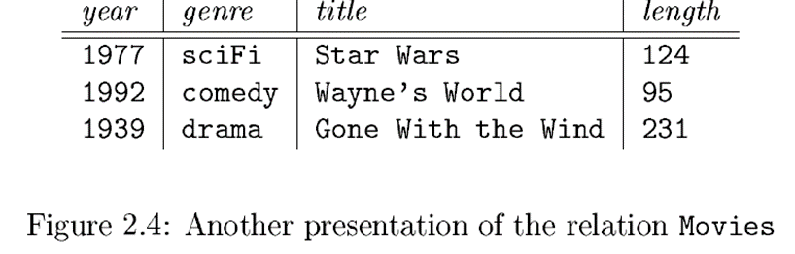
Equivalent representations of a relation
Can we reorder the attributes of the relation as we like without changing the relation? Yes, possible
But, when the order of attributes in the schema change (or reorder the columns) then the components of the tuples should also change accordingly
These two relations (Figure 2.1 and Figure 2.4) are ‘considered the same’

Slide 26
Relation instances and the ‘current instance’
not static
relation instances (or the contents of the table) changes over time
insert new tuples for new movies
make changes to existing tuples (say, if the information is wrong, we should update it)
delete a whole tuple to remove a certain movie from the database
a set of tuples for a given relation at a particular time ‘an instance’ of that relation
the contents of a relation are dynamic

Slide 27
Could the schema of a relation change?
normally less common, but possible
we may want to add or delete some attributes or alter the table (relation)
better to design the schema correctly in the 1st place than do ad-hoc alterations

Slide 28
Keys of relations
many constraints on relations placed on database schemas (discussed later)
one kind of constraint is very fundamental: key constraints
A key is a minimal subset of attributes that acts as a unique identifier for tuples in a relation
A key is an attribute whose values are unique (normally underlined in the schema)

Slide 29
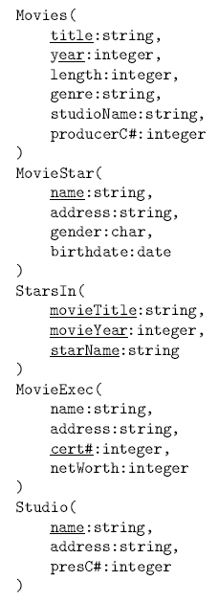
Declaring Database Schema (Figure 2.5 in the text book)
Notes:
The schema consists of following relations: Movies, MovieStar, StarsIn, MovieExec and Studio

Slide 30
Home work
read section 2.3.2 to get familiar with data types used in SQL
for Exam Practice: Do exercises 2.2.1 to 2.2.3

Slide 31
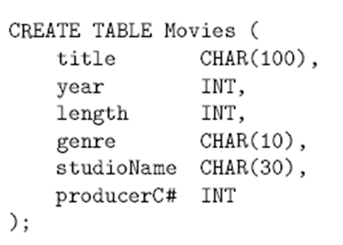
Simple table declarations
Notes:
Should think about reasonable lengths for attributes which are strings

Slide 32
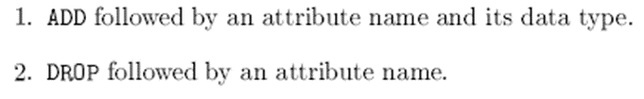


SQL statements to modify relation schema
SQL statements to modify relation schema
Modify schema of an existing relation

Slide 33
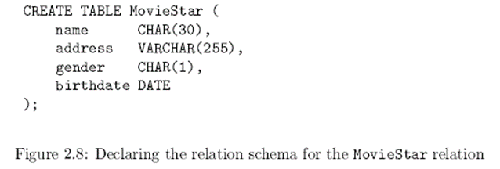

Setting default values when creating tables
In general, when declaring an attribute and its data type while creating tables it is possible to use the keyword DEFAULT and an appropriate value
In this table declaration it is possible to use DEFAULT types for ‘gender’ and ‘birthdate’ as follows:

Slide 34
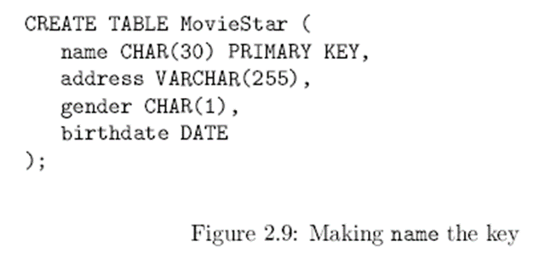
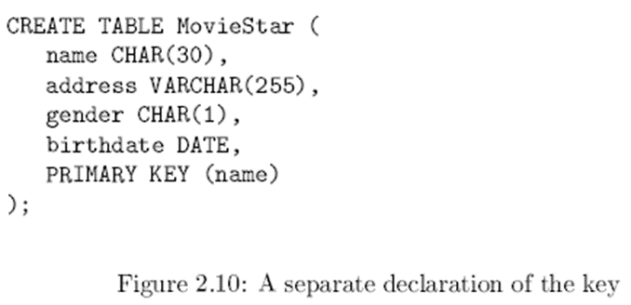
Ways to declare keys in a table (relation): when the key contains only one attribute

Slide 35
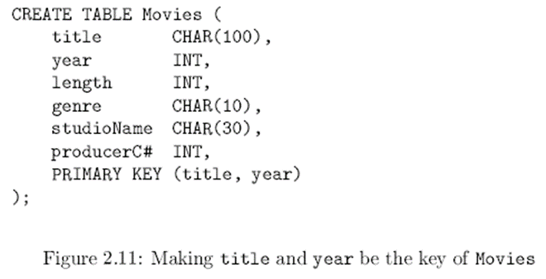
Ways to declare keys in a table (relation): when the key contains two attributes

Slide 36
For exam practice do exercises for section 2.3
Section 2.4 onwards covered later under relational algebra

Slide 37
Single-table queries

Slide 38
What you will learn about in this section
The SFW query
Other useful operators: LIKE, DISTINCT, ORDER BY

Slide 39
SQL Query
Lecture 2 > Section 2 > SFW
Basic form (there are many many more bells and whistles)
SELECT <attributes> FROM <one or more relations> WHERE <conditions>
Call this a SFW query.

Slide 40
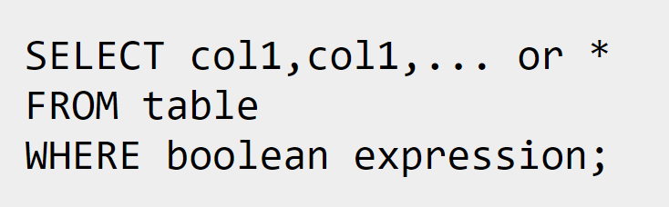
The first line says which columns from the table you want returned. The * is a wildcard meaning "all columns“
The FROM clause comes second. Clauses in a SQL statement always go in a particular order. It says what table you are searching through
The WHERE clause comes third. It gives a Boolean expression to filter the rows of the table. The query returns all rows for which the Boolean expression is true. That might be no rows at all, all of them, or a subset

Slide 41
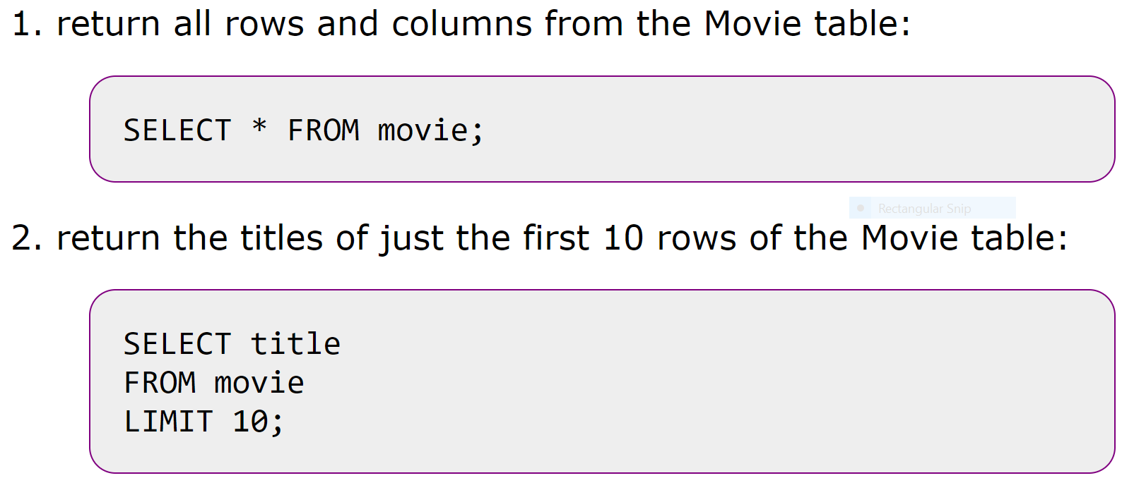
Examples
Notes:
1st is a selection while the 2nd is a projection

Slide 42
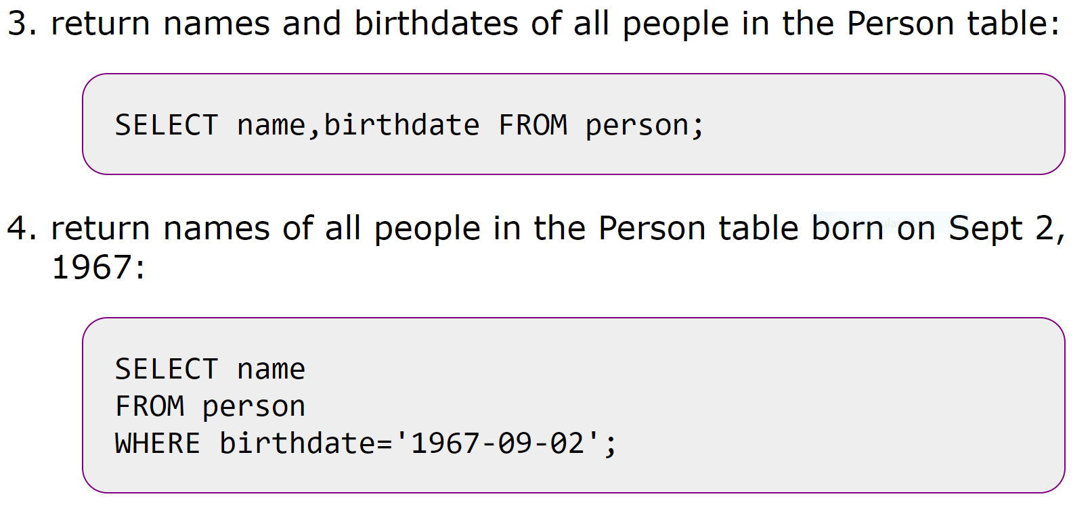
Examples
Notes:
Both projections

Slide 43
Simple SQL Query: Selection
Lecture 2 > Section 2 > SFW
PName | Price | Category | Manufacturer
Gizmo | $19.99 | Gadgets | GizmoWorks
Powergizmo | $29.99 | Gadgets | GizmoWorks
SingleTouch | $149.99 | Photography | Canon
MultiTouch | $203.99 | Household | Hitachi
Selection is the operation of filtering a relation’s tuples on some condition
SELECT * FROM Product WHERE Category = ‘Gadgets’
PName | Price | Category | Manufacturer
Gizmo | $19.99 | Gadgets | GizmoWorks
Powergizmo | $29.99 | Gadgets | GizmoWorks

Slide 44
Simple SQL Query: Projection
Lecture 2 > Section 2 > SFW
PName | Price | Category | Manufacturer
Gizmo | $19.99 | Gadgets | GizmoWorks
Powergizmo | $29.99 | Gadgets | GizmoWorks
SingleTouch | $149.99 | Photography | Canon
MultiTouch | $203.99 | Household | Hitachi
Projection is the operation of producing an output table with tuples that have a subset of their prior attributes
SELECT Pname, Price, Manufacturer FROM Product WHERE Category = ‘Gadgets’
PName | Price | Manufacturer
Gizmo | $19.99 | GizmoWorks
Powergizmo | $29.99 | GizmoWorks

Slide 45
Notation
Lecture 2 > Section 2 > SFW
Input schema
Product(PName, Price, Category, Manfacturer)
SELECT Pname, Price, Manufacturer FROM Product WHERE Category = ‘Gadgets’
Output schema
Answer(PName, Price, Manfacturer)

Slide 46
A Few Details
Lecture 2 > Section 2 > SFW
SQL commands are case insensitive:
Same: SELECT, Select, select
Same: Product, product
Values are not:
Different: ‘Seattle’, ‘seattle’
Use single quotes for constants:
‘abc’ - yes
“abc” - no

Slide 47
LIKE: Simple String Pattern Matching
Lecture 2 > Section 2 > Other operators
SELECT * FROM Products WHERE PName LIKE ‘%gizmo%’
s LIKE p: pattern matching on strings
p may contain two special symbols:
% = any sequence of characters
_ = any single character

Slide 48
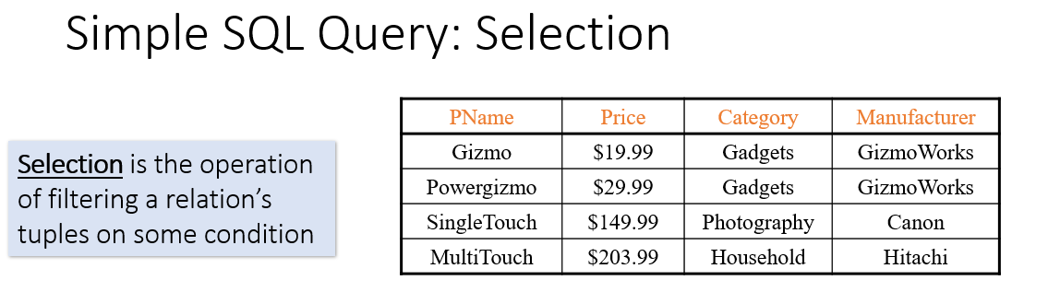


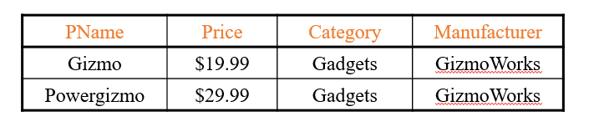

Slide 49
DISTINCT: Eliminating Duplicates
Lecture 2 > Section 2 > Other operators
Category
Gadgets
Photography
Household
SELECT DISTINCT Category
FROM Product
Versus
Category
Gadgets
Gadgets
Photography
Household
SELECT Category
FROM Product

Slide 50
ORDER BY: Sorting the Results
Lecture 2 > Section 2 > Other operators
SELECT PName, Price, Manufacturer
FROM Product
WHERE Category=‘gizmo’ AND Price > 50
ORDER BY Price, PName
Ties are broken by the second attribute on the ORDER BY list, etc.
Ordering is ascending, unless you specify the DESC keyword.

Slide 51
Practice online
SQL Tutorial https://www.w3schools.com/sql/default.asp
SQL zoo https://sqlzoo.net/wiki/SQL_Tutorial
Check for more sites What is the best website to practice SQL queries?
https://www.quora.com/What-is-the-best-website-to-practice-SQL-queries

Slide 52
Practice on your computer
Check ‘Professor Bill Bird’s SQLite tutorial’ uploaded on the course website in Connex

Slide 53
Additional reading material on SQL
The following book on SQL queries is available online for free through the University's licensing agreement.
Beginning SQL Queries (Second Edition) by Clare Churcher (Apress, 2016)
Note that the Churcher book is written for Microsoft SQL platforms, so some advanced or esoteric aspects of the SQL syntax described in the book will not apply to the SQL servers we use in this course.
(Link and explanatory text provided by Professor Bill Bird for his lectures given in CSC 370 - Spring 2018)

Slide 54
Additional reading material on SQL standards
A platform-agnostic SQL reference (which documents the basic standard SQL features that all platforms will share) is available at W3Schools.
Finally, for a more detailed survey of specific SQL features, you may want to consult the Wikipedia articles for the different SQL standards.
SQL-92
SQL 1999
SQL 2003
SQL 2006
SQL 2008
SQL 2011
SQL 2016 (for interest only, not supported by PostgreSQL 9.5)
(Link and explanatory text provided by Professor Bill Bird for his lectures given in CSC 370 - Spring 2018)

Slide 55
Exam preparation exercise from Google BigQuery
Watch the video Correlation with BigQuery
https://www.youtube.com/watch?v=tqS4vZ2Rxlo
Write down all queries (other than table joins) done during the presentation in plain English. You should be able to translate back from your written plain English statement to each an every relevant query shown in the presentation.
State assumptions they made (if any)
Refer PostgreSQL querying a table with SQL SELECT statement, example: https://www.postgresql.org/docs/9.4/tutorial-select.html

Slide 56
Some advice on learning terminology associated with databases
While reading is an acquired habit speech/listening to others (the oral
tradition) is natural to humans
When learning new terminology in any academic discipline a better
strategy would be to listen to some online lectures to internalize the
concepts by listening and then read relevant material
For example you could listen to following lectures:
Introduction to Databases https://lagunita.stanford.edu/courses/DB/2014/SelfPaced/about

Slide 57
Create your assignment journal as a Jupyter Notebook?
Check https://jupyter.org/try (if you have time/already know)
Main concern should be legible; could be a text or a word file
Concentrate mainly on learning database concepts (only 3 months)

Slide 58
Acknowledgment:
Some slides/material taken from lectures presented in these courses:
SQLite tutorial & additional reading material from Professor Bill Bird’s lectures given in CSC 370 - Spring 2018
CS564 Database Management Systems https://thodrek.github.io/cs564-fall17/
Queries http://cs.wellesley.edu/~cs304/lectures/queries/

Slide 59
to form teams with complementary skills you can do a self-assessment about your qualities
leadership/take initiative
creativity
programming skills
social skills/resolve conflicts
subject knowledge
critical thinking
*what is important is you should be able to make a significant contribution to the group/team effort

Slide 60


